Slide 1
A Graph Theoretic Approach for Maximizing Target Coverage using Minimum Directional Sensors in Randomly Deployed Wireless Sensor Networks
Sakshar Chakravarty (1305002)
Laboni Sarker (1305115)
Supervised By
Dr. A K M Ashikur Rahman
Professor, CSE, BUET

Slide 2
Introduction
A system consisting of wireless sensors and targets
Both deployed randomly

Slide 3
Introduction (Contd.)
2 types of sensors:
Isotropic
Circular coverage
Directional (within the scope of this thesis)
Coverage in a particular direction
example: camera

Slide 4
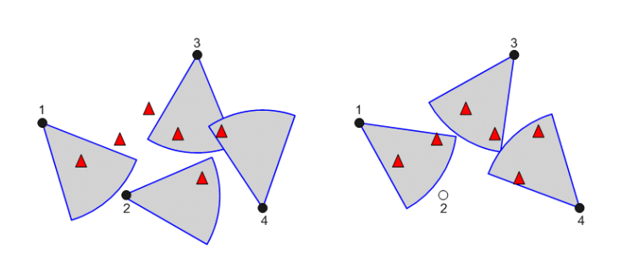
Introduction (Contd.)
Fig: A random deployment scenario

Slide 5
Applications
Area surveillance
Tracking and environmental monitoring
Telecommunications

Slide 6
Visual Sensor Network Parameters
FOV(Field of View): It is the sensing region of a sensor/extent of sensing region which can be captured at any direction.
Used sensors: Pan-tilt-zoom cameras
Our assumptions: Pan-only Cameras

Slide 7
Defining pan of a camera
Parameters:
Range
Angle: Also known as angle of view(AOV)
Number of pans: Depend on the angle.
If the angle is 45 degree, the number of pan will be eight (8)
Assumption: We will consider homogeneous cameras (the parameters will be same for all cameras)

Slide 8
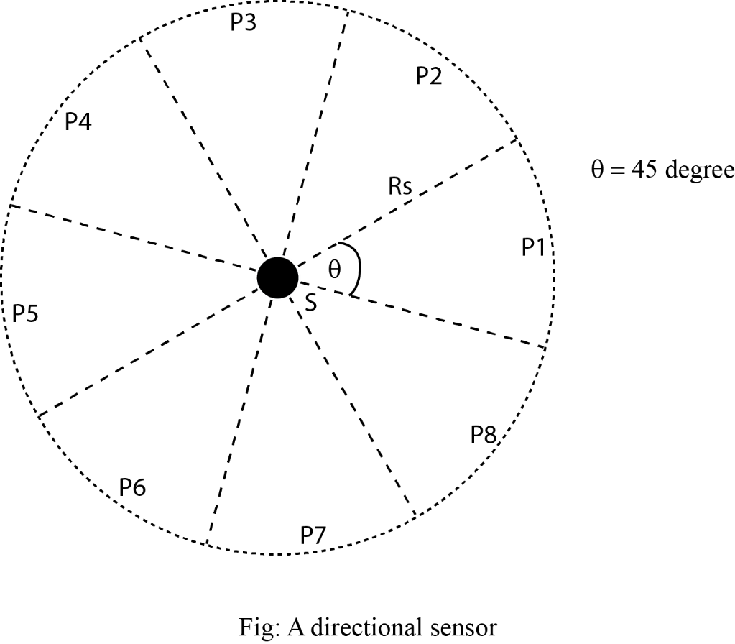
A directional/visual sensor with parameters

Slide 9
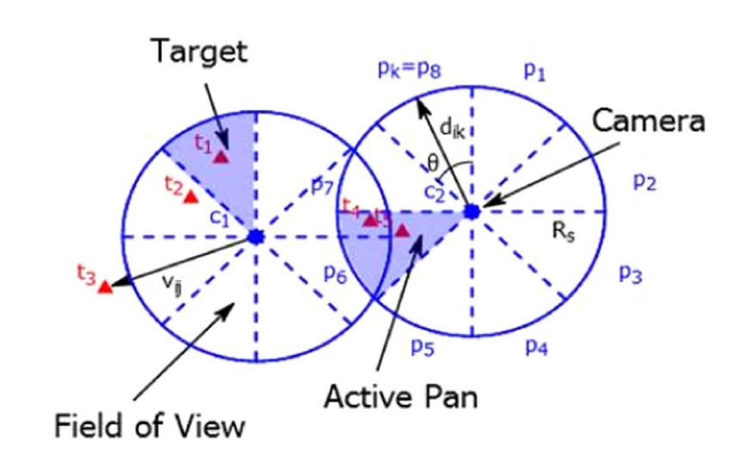

Testing a target in any pan of a camera
TIS test: this means target in sector (pan) test.
Formula:
$φ_{ij}=\cos^{−1}\left(\frac{\vec{d_{ik}}. \vec{v_{ij}}}{\left|\vec{d_{ik}}\right|\left| \vec{v_{ij}}\right|}\right)$

Slide 10
System Classification
2 classes of deployment on the basis of the ratio between the number of directional sensors and targets:
Under Provisioned System
No point of minimization of active sensors.
Over Provisioned System (within the scope of this thesis)
Minimization of active sensors is an important aspect

Slide 11
Objectives
Maximization of target coverage
Minimization of active sensors
It is an NP-hard problem.
Formulate different heuristics to achieve a near optimal solution better than the existing one’s

Slide 12
Literature Review
Work | Principle | Description | Comments
Ai and Abouzeid 2006 | Sensor-oriented Greedy Heuristic | Integer Linear Programming (ILP) Centralized Greedy Algorithm (CGA) Distributed Greedy Algorithm (DGA) | Poor performance in over-provisioned system ILP is not scalable to solve large scale scenario CGA and DGA fail to resolve tie between sensors

Slide 13
Literature Review
Work | Principle | Description | Comments
Munishwar and Abu-Ghazaleh 2013 | Sensor-oriented Modified Greedy Heuristic | Centralized Force-directed Algorithm (CFA): Priority is given to the sensors covering targets in a single pan. | Poor performance in over-provisioned system Fails to minimize the number of active sensors

Slide 14
Literature Review
Work | Principle | Description | Comments
Munishwar et al. 2011 | Sensor-oriented Communication between sensors | Distributed Force-directed Algorithm (DFA): Each sensor assigns a unique priority Area based or target based approach Each sensor orients itself towards maximal coverage pan. This orientation information exchanged among sensors. If overlapping coverage found, higher priority sensor prevails. | Fails to minimize the number of active sensors

Slide 15
Literature Review
Work | Principle | Description | Comments
H. Zannat et al. 2016 | Target-oriented | Greedy Target Oriented Heuristic (GTOH) Pure Target Oriented Heuristic (PTOH) Hybrid Target Oriented Heuristic (HTOH) | Fails to minimize the number of active sensors.

Slide 16
Literature Review
Work | Principle | Description | Comments
Fusco and Gupta 2009 | k-coverage problem | Centralized Greedy Algorithm: Assumption: Each sensor has overlapping pans instead of discrete pans. | Huge variation among targets in achieving the desired k-coverage.
 | Some approximation algorithms related to directional sensors | orient all the given sensors in order to maximize coverage place and orient a minimum number of sensors in order to cover the given area place and orient the given number of sensors to maximize the area covered

Slide 17
Literature Review
Work | Principle | Description | Comments
Malek et al. 2016 | Balanced k-coverage problem | Improved the k-coverage solution proposed by Fusco and Gupta (2009) to achieve balanced k-coverage. | Reduced the number of uncovered targets as well as providing k-coverage to targets as much as possible

Slide 18
Overview of literature
All the heuristics are formulated based on greedy approach
Either sensor-oriented or target-oriented
In all the works, selection of a sensor and fixing its orientation are merged into a single step
Most of them fail to achieve active sensor minimization, only focusing on coverage maximization
k-coverage problems address fault tolerance issue, we limit ourselves only to 1-coverage.

Slide 19
Proposed Contributions
Fusing both Sensor-oriented & Target-oriented approach
Splitting the step of selection of sensor and orientation
Model the problem in graph theoretic approach

Slide 20
Graph Modeling
Nodes: Sensors (Cameras)
Edges
Conflict of targets
Target-oriented approach: emphasizes on non-conflicted targets. That means it gives more priority to those targets which are non-conflicted one.
Model a weighted multi-graph

Slide 21
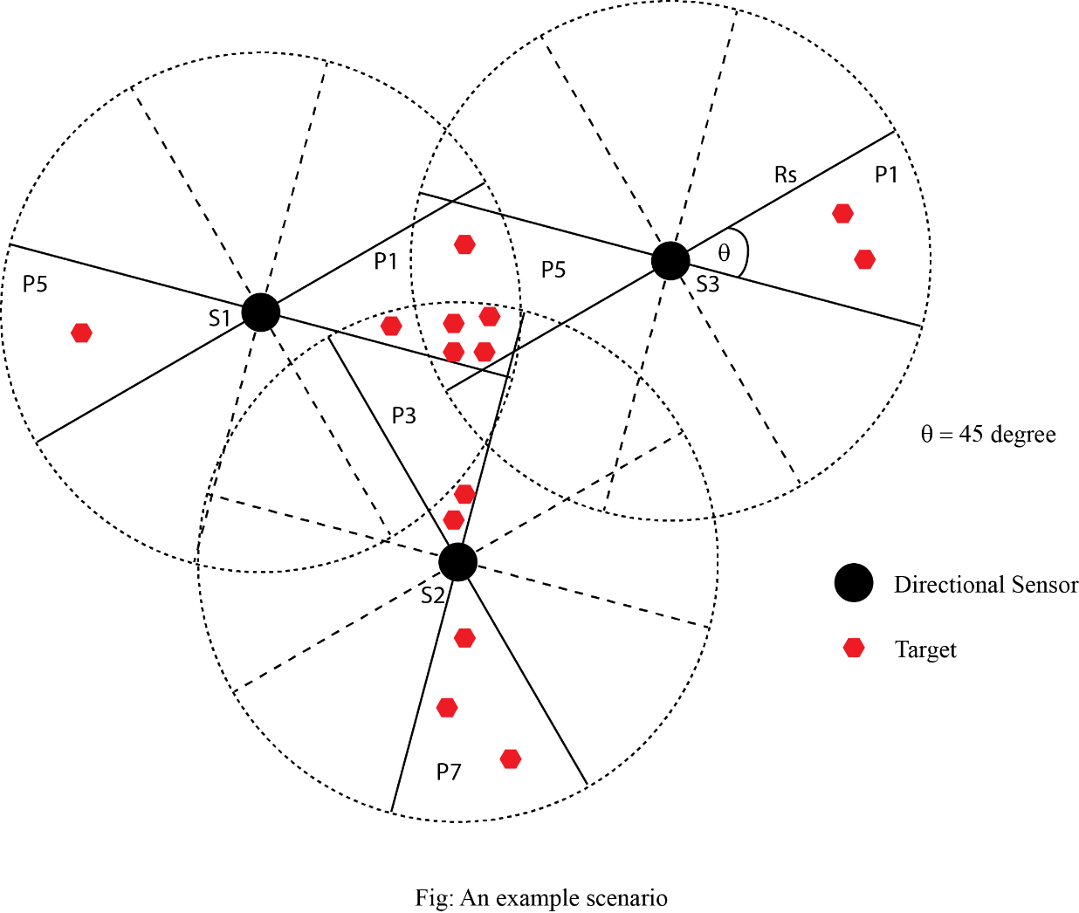
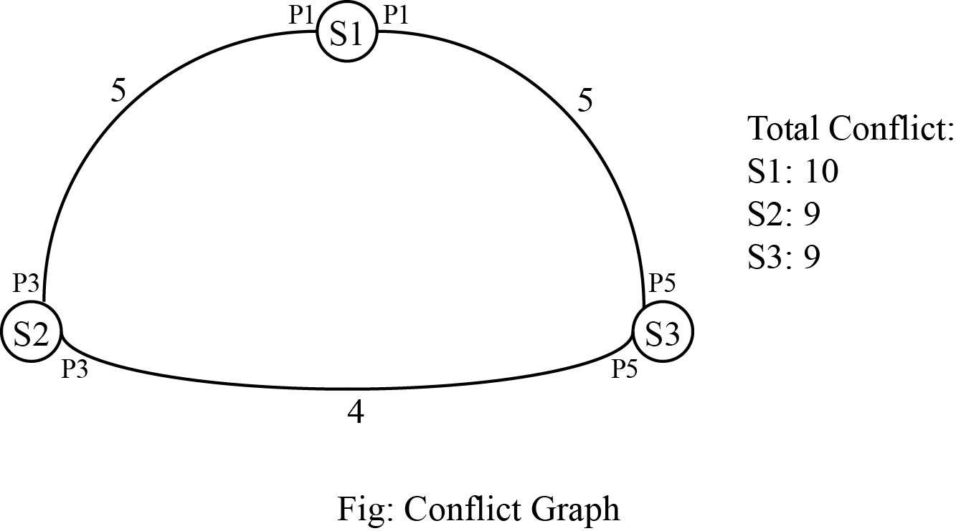
Example

Slide 22
Selection of Sensors
Different heuristics
Total maximum conflicts of the nodes
Total minimum conflicts of the nodes

Slide 23
Orientation of the selected sensor
Greedy approach
That orientation which will cover the total maximum number of targets
We can also choose the orientation with the maximum/minimum conflict

Slide 24
Reason behind conflict graph
If we resolve the conflicted targets at first, then the rest sensors can focus on the non-conflicted targets.
Again, if we consider the sensors with the sensors with minimum conflicts, then we emphasize more on the non-conflicted targets.

Slide 25
Achieving target-oriented nature
When we have the information of the conflicted targets for each nodes, then we have also the idea of the non-conflicted targets.
Shadow edge: There will the self-edges for each node/sensors keeping the number of non-conflicted targets for each orientations.
Actually without looking at the targets, we can get the total knowledge of lonely targets and conflicted targets.

Slide 26
Localized search
In greedy-approach, when a sensor and its orientation is selected the targets covered by that orientation of the sensor should be removed from the sensors which also cover those targets. For this task, whole set of remaining sensors should be checked.
In our model, the task become localized. When we select a sensor, we know the sensors with which the sensor has conflict.

Slide 27
Time complexity
The localized search will reduce the run time than the greedy one.

Slide 28
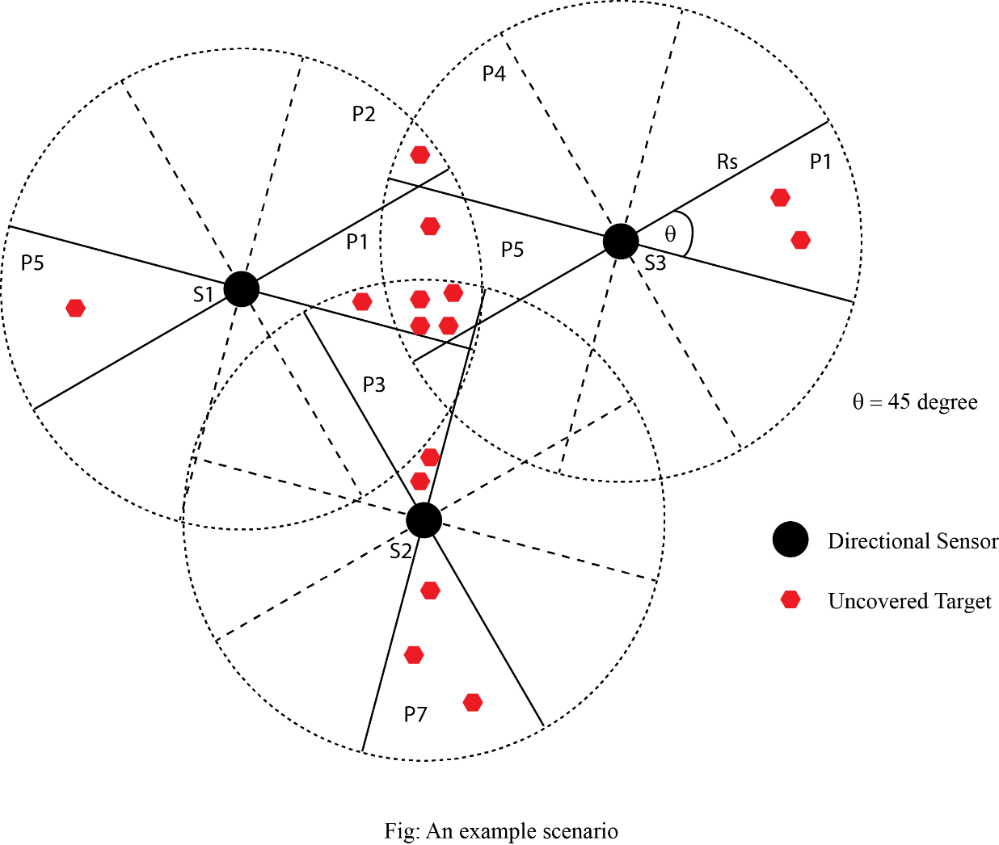
Comparison of different heuristics

Slide 29
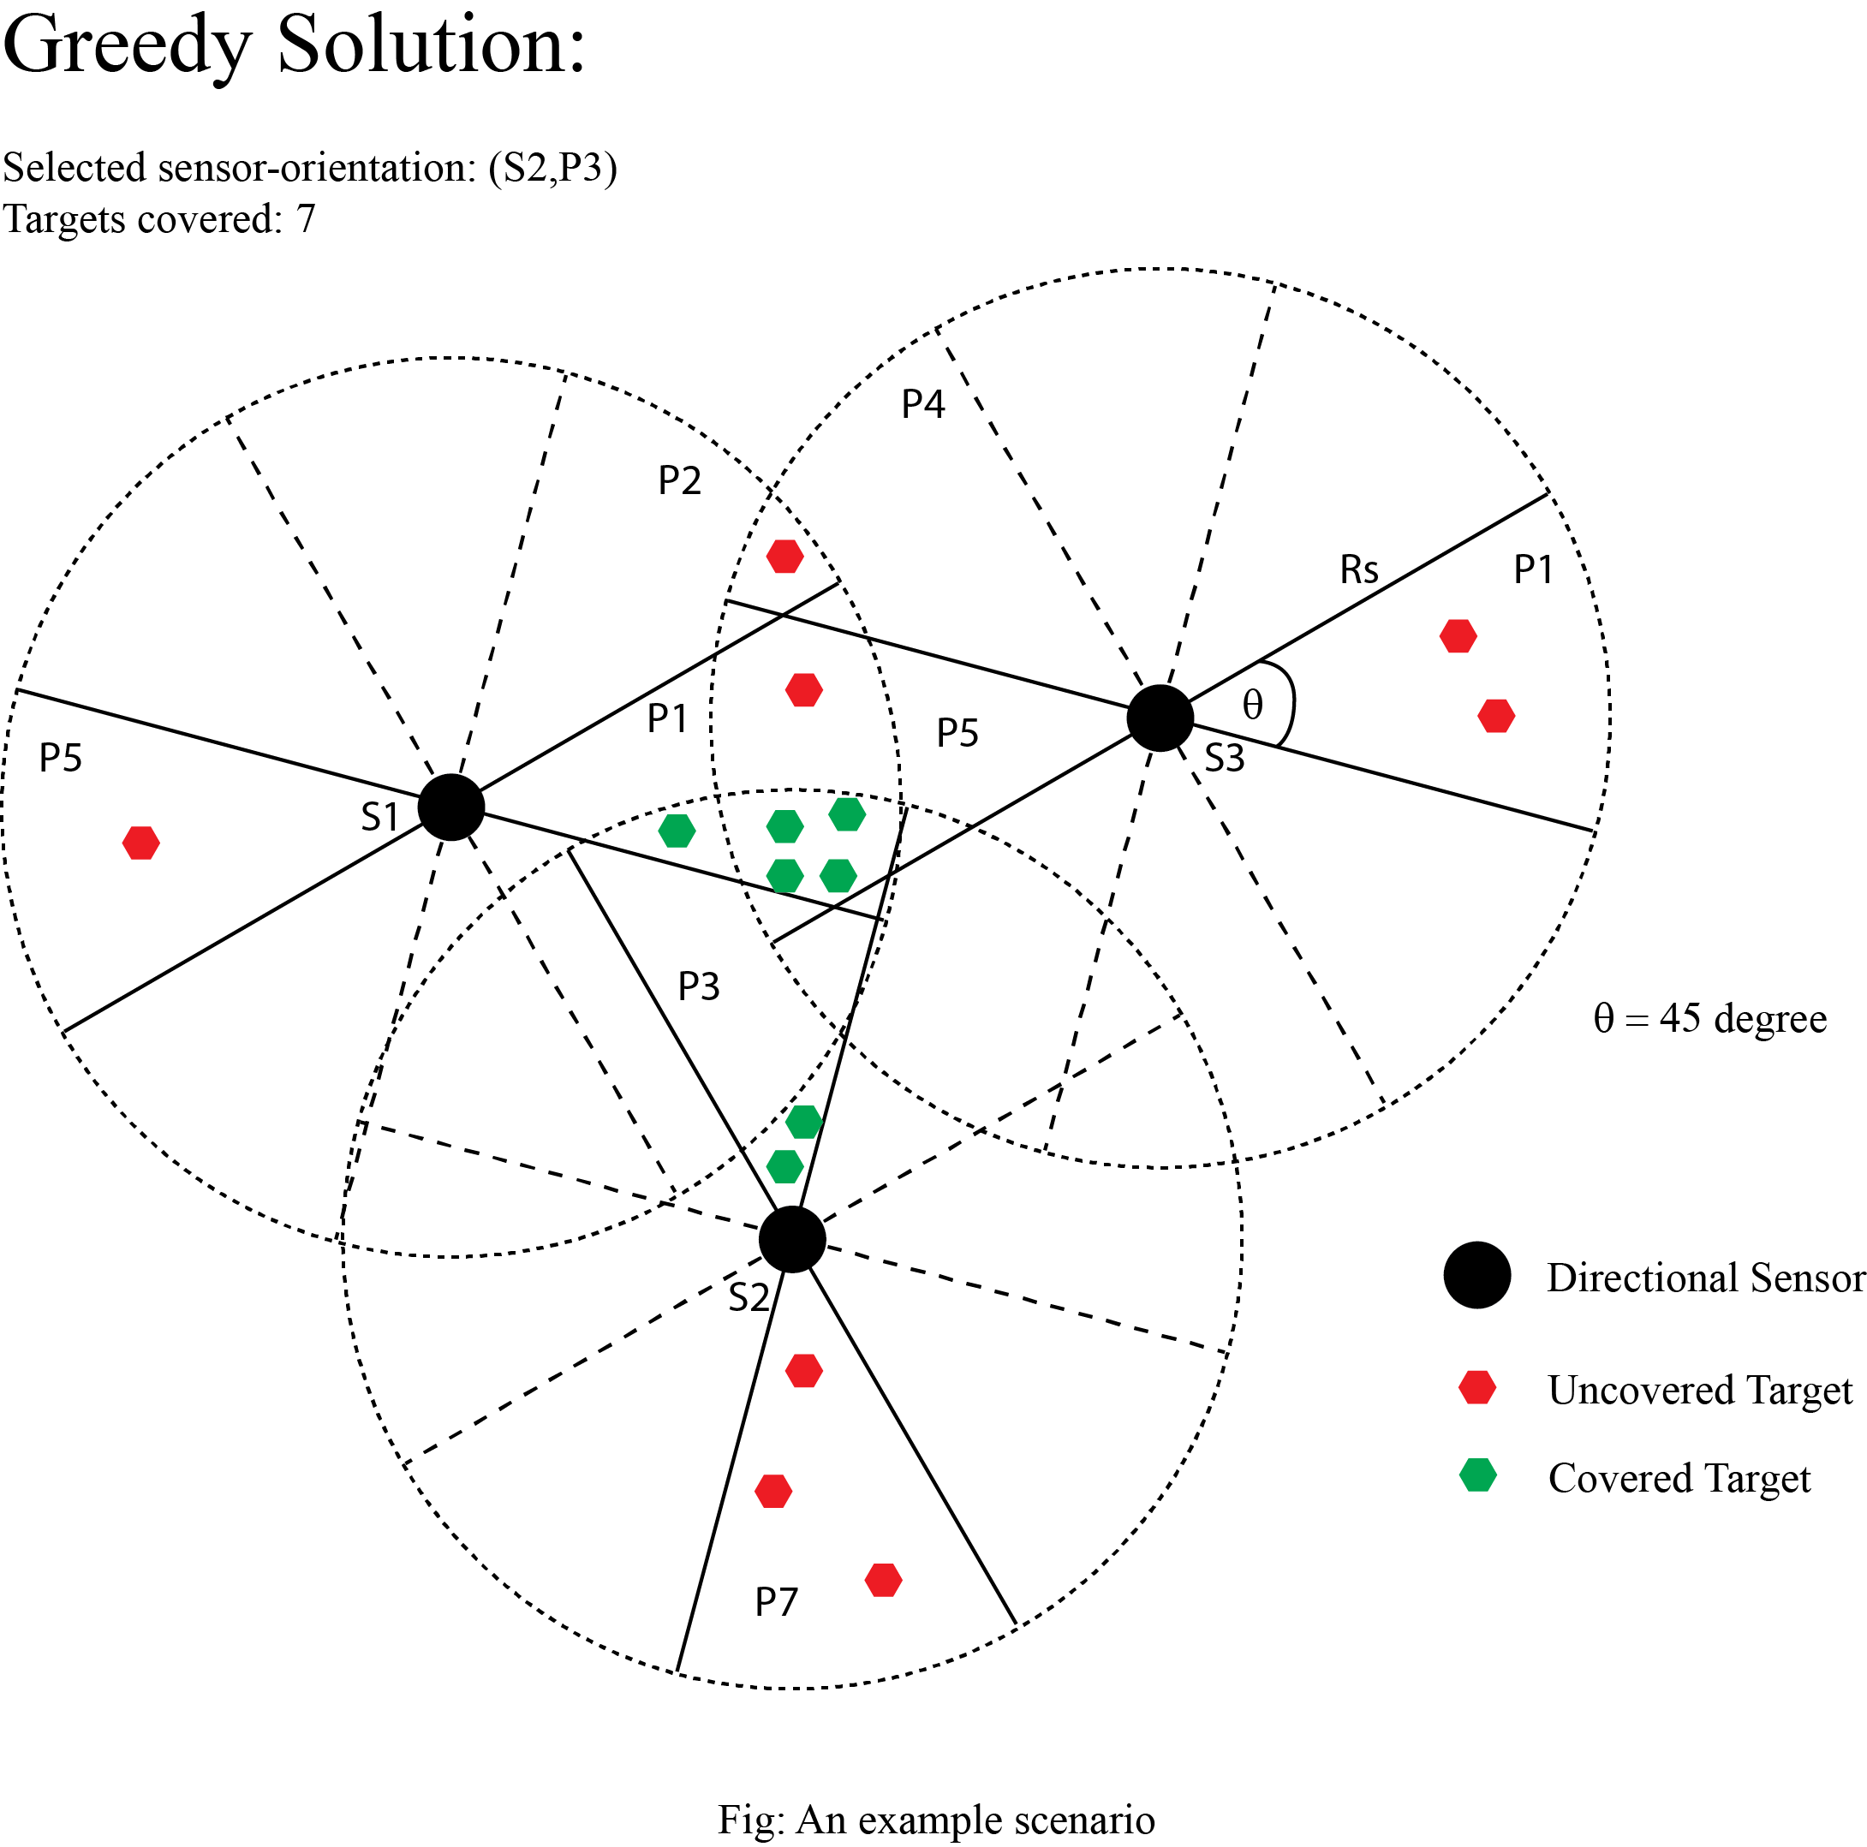

Slide 30
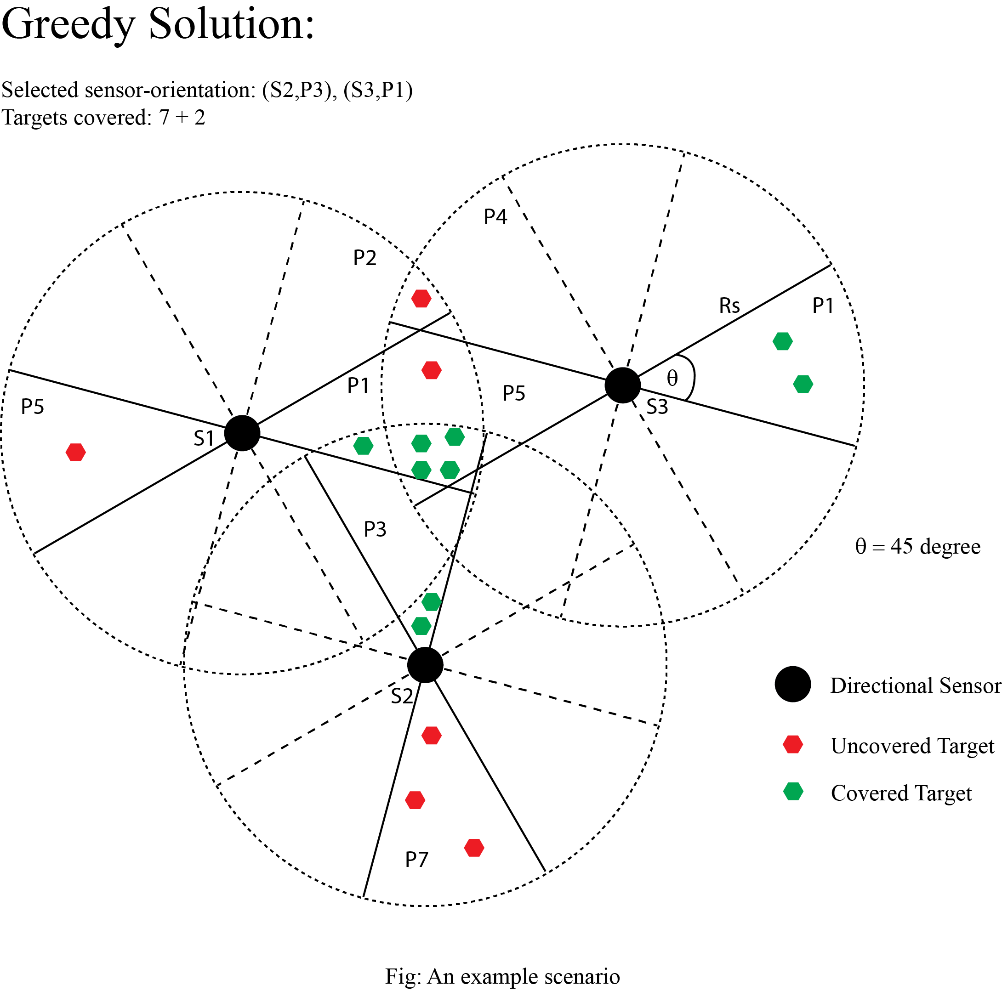

Slide 31
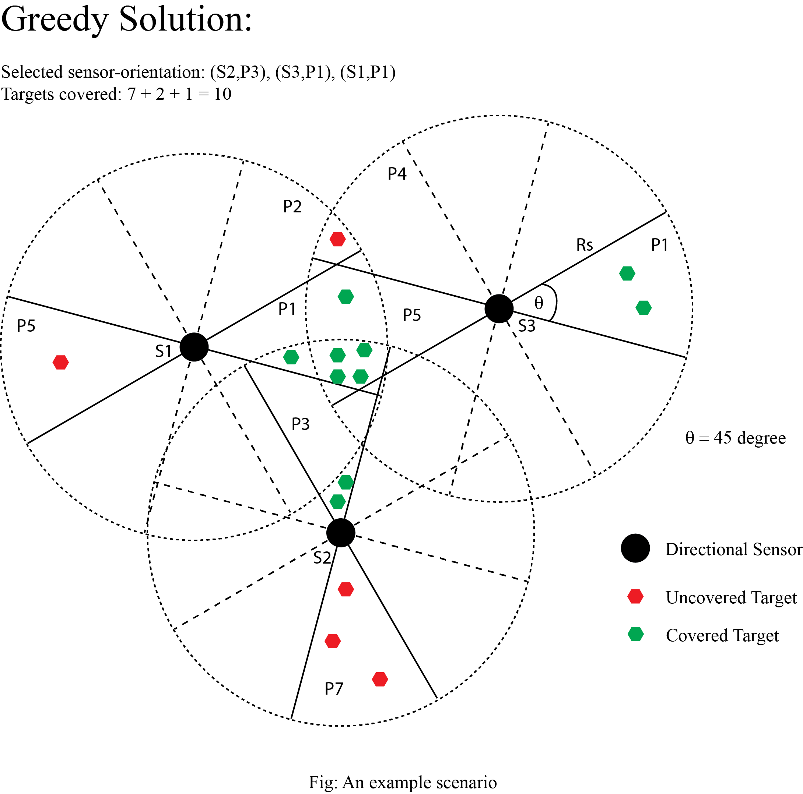

Slide 32
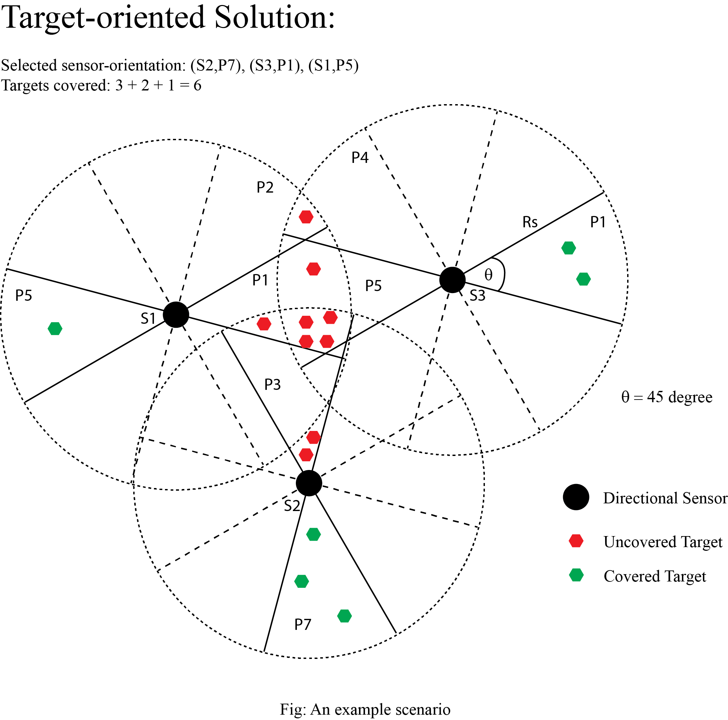

Slide 33
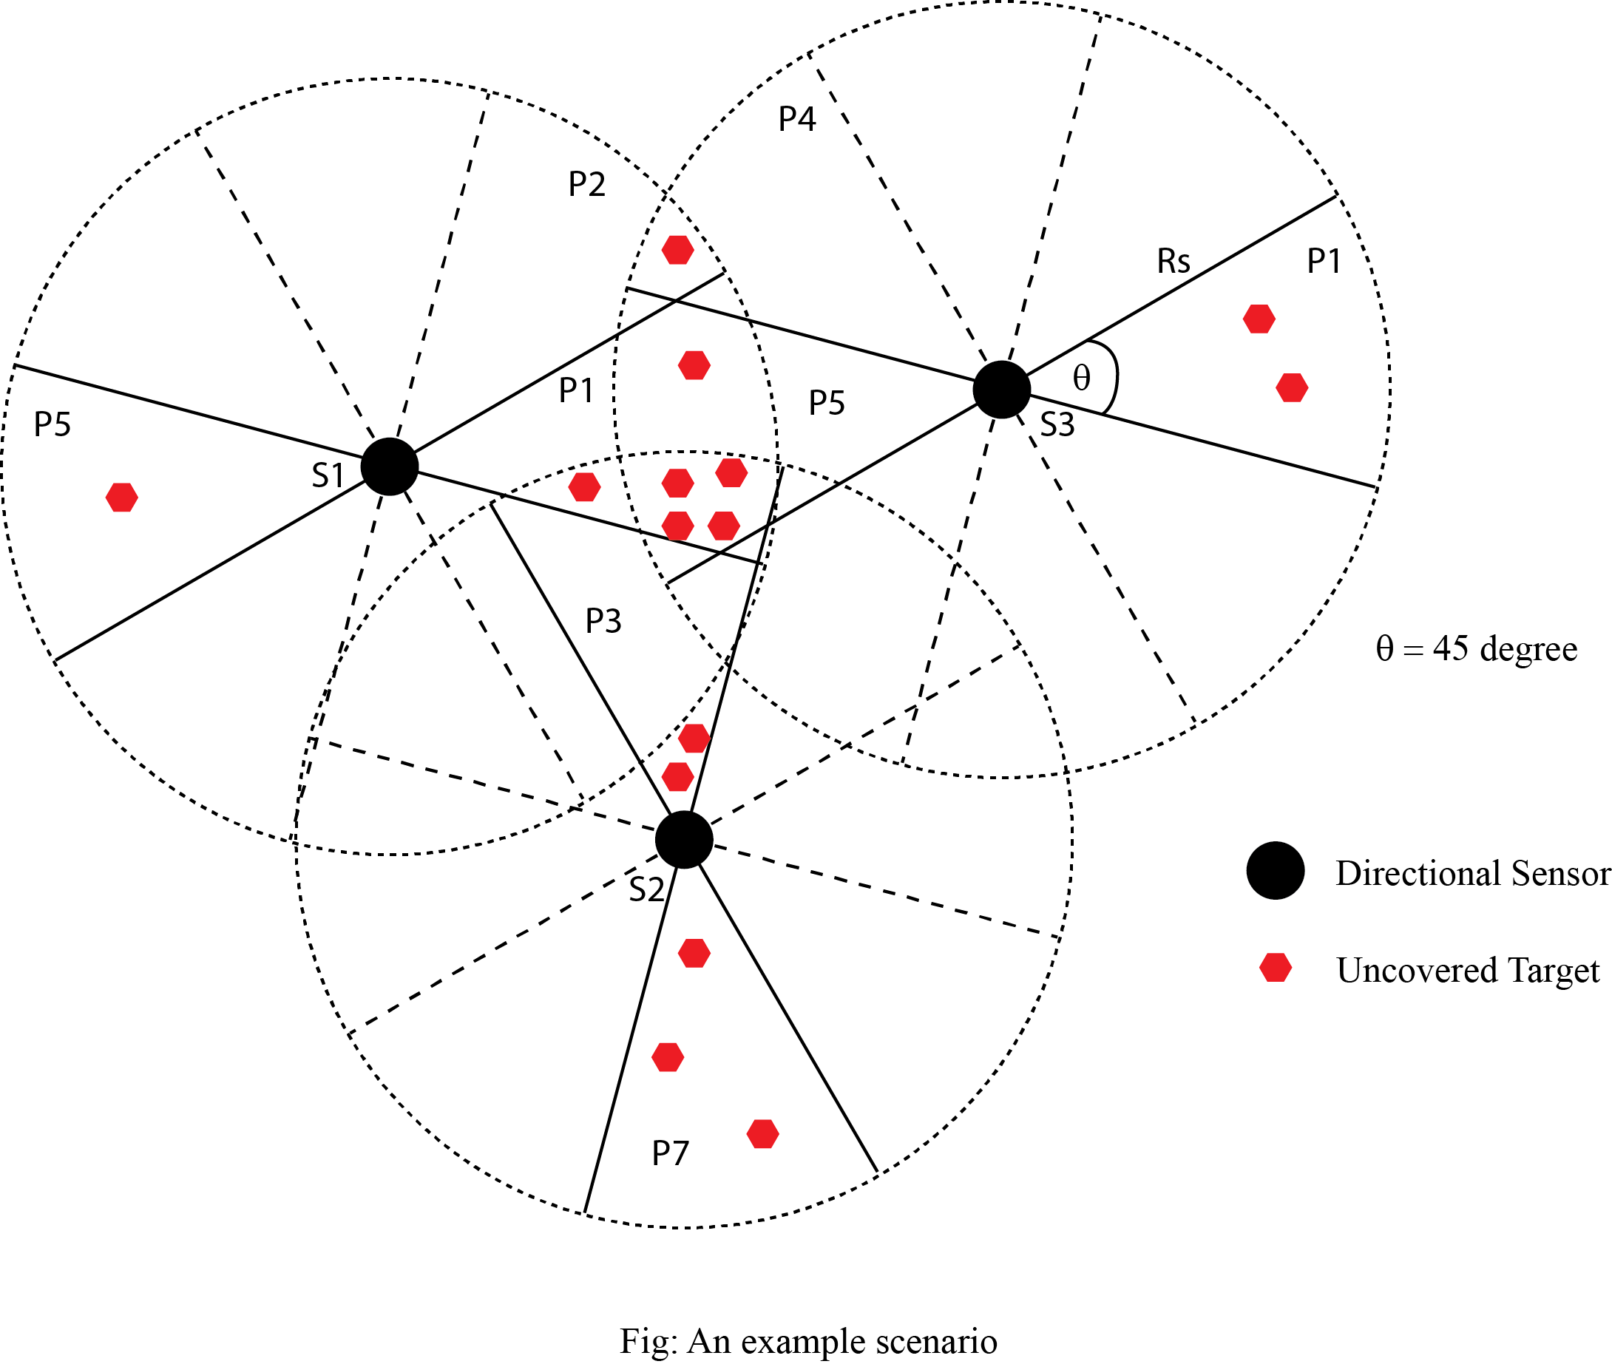
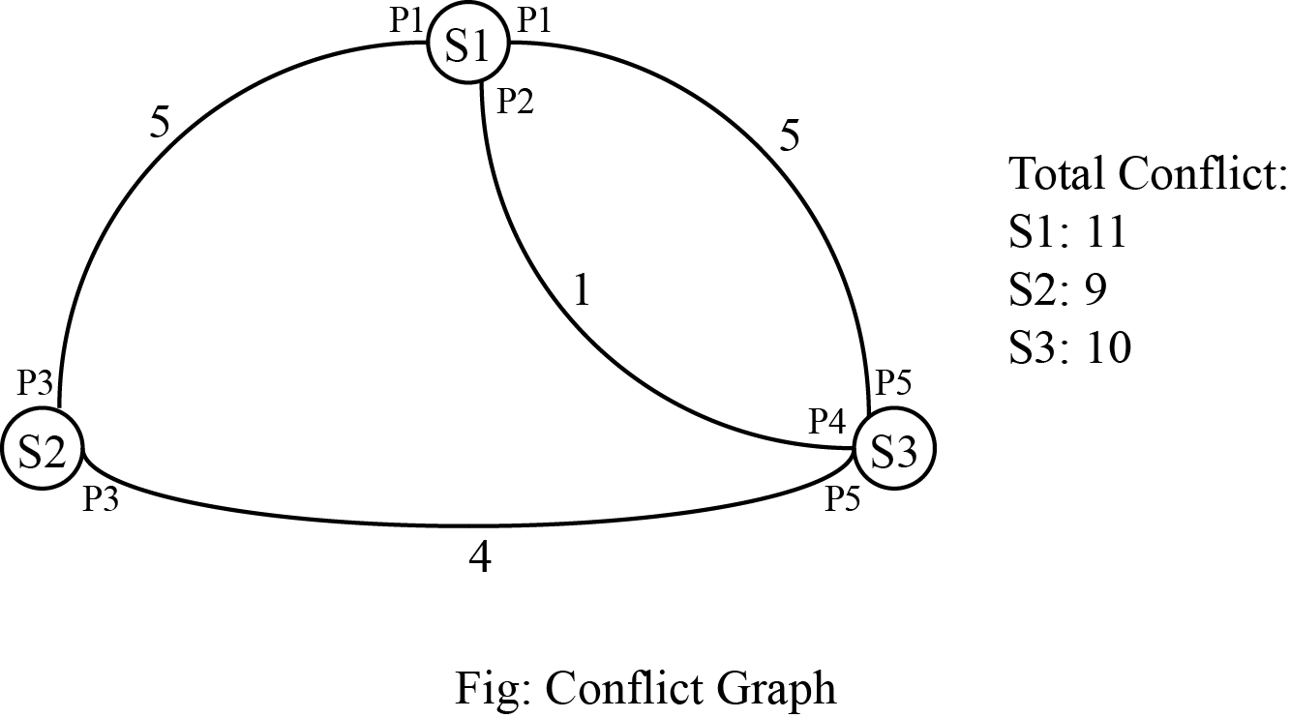

Slide 34
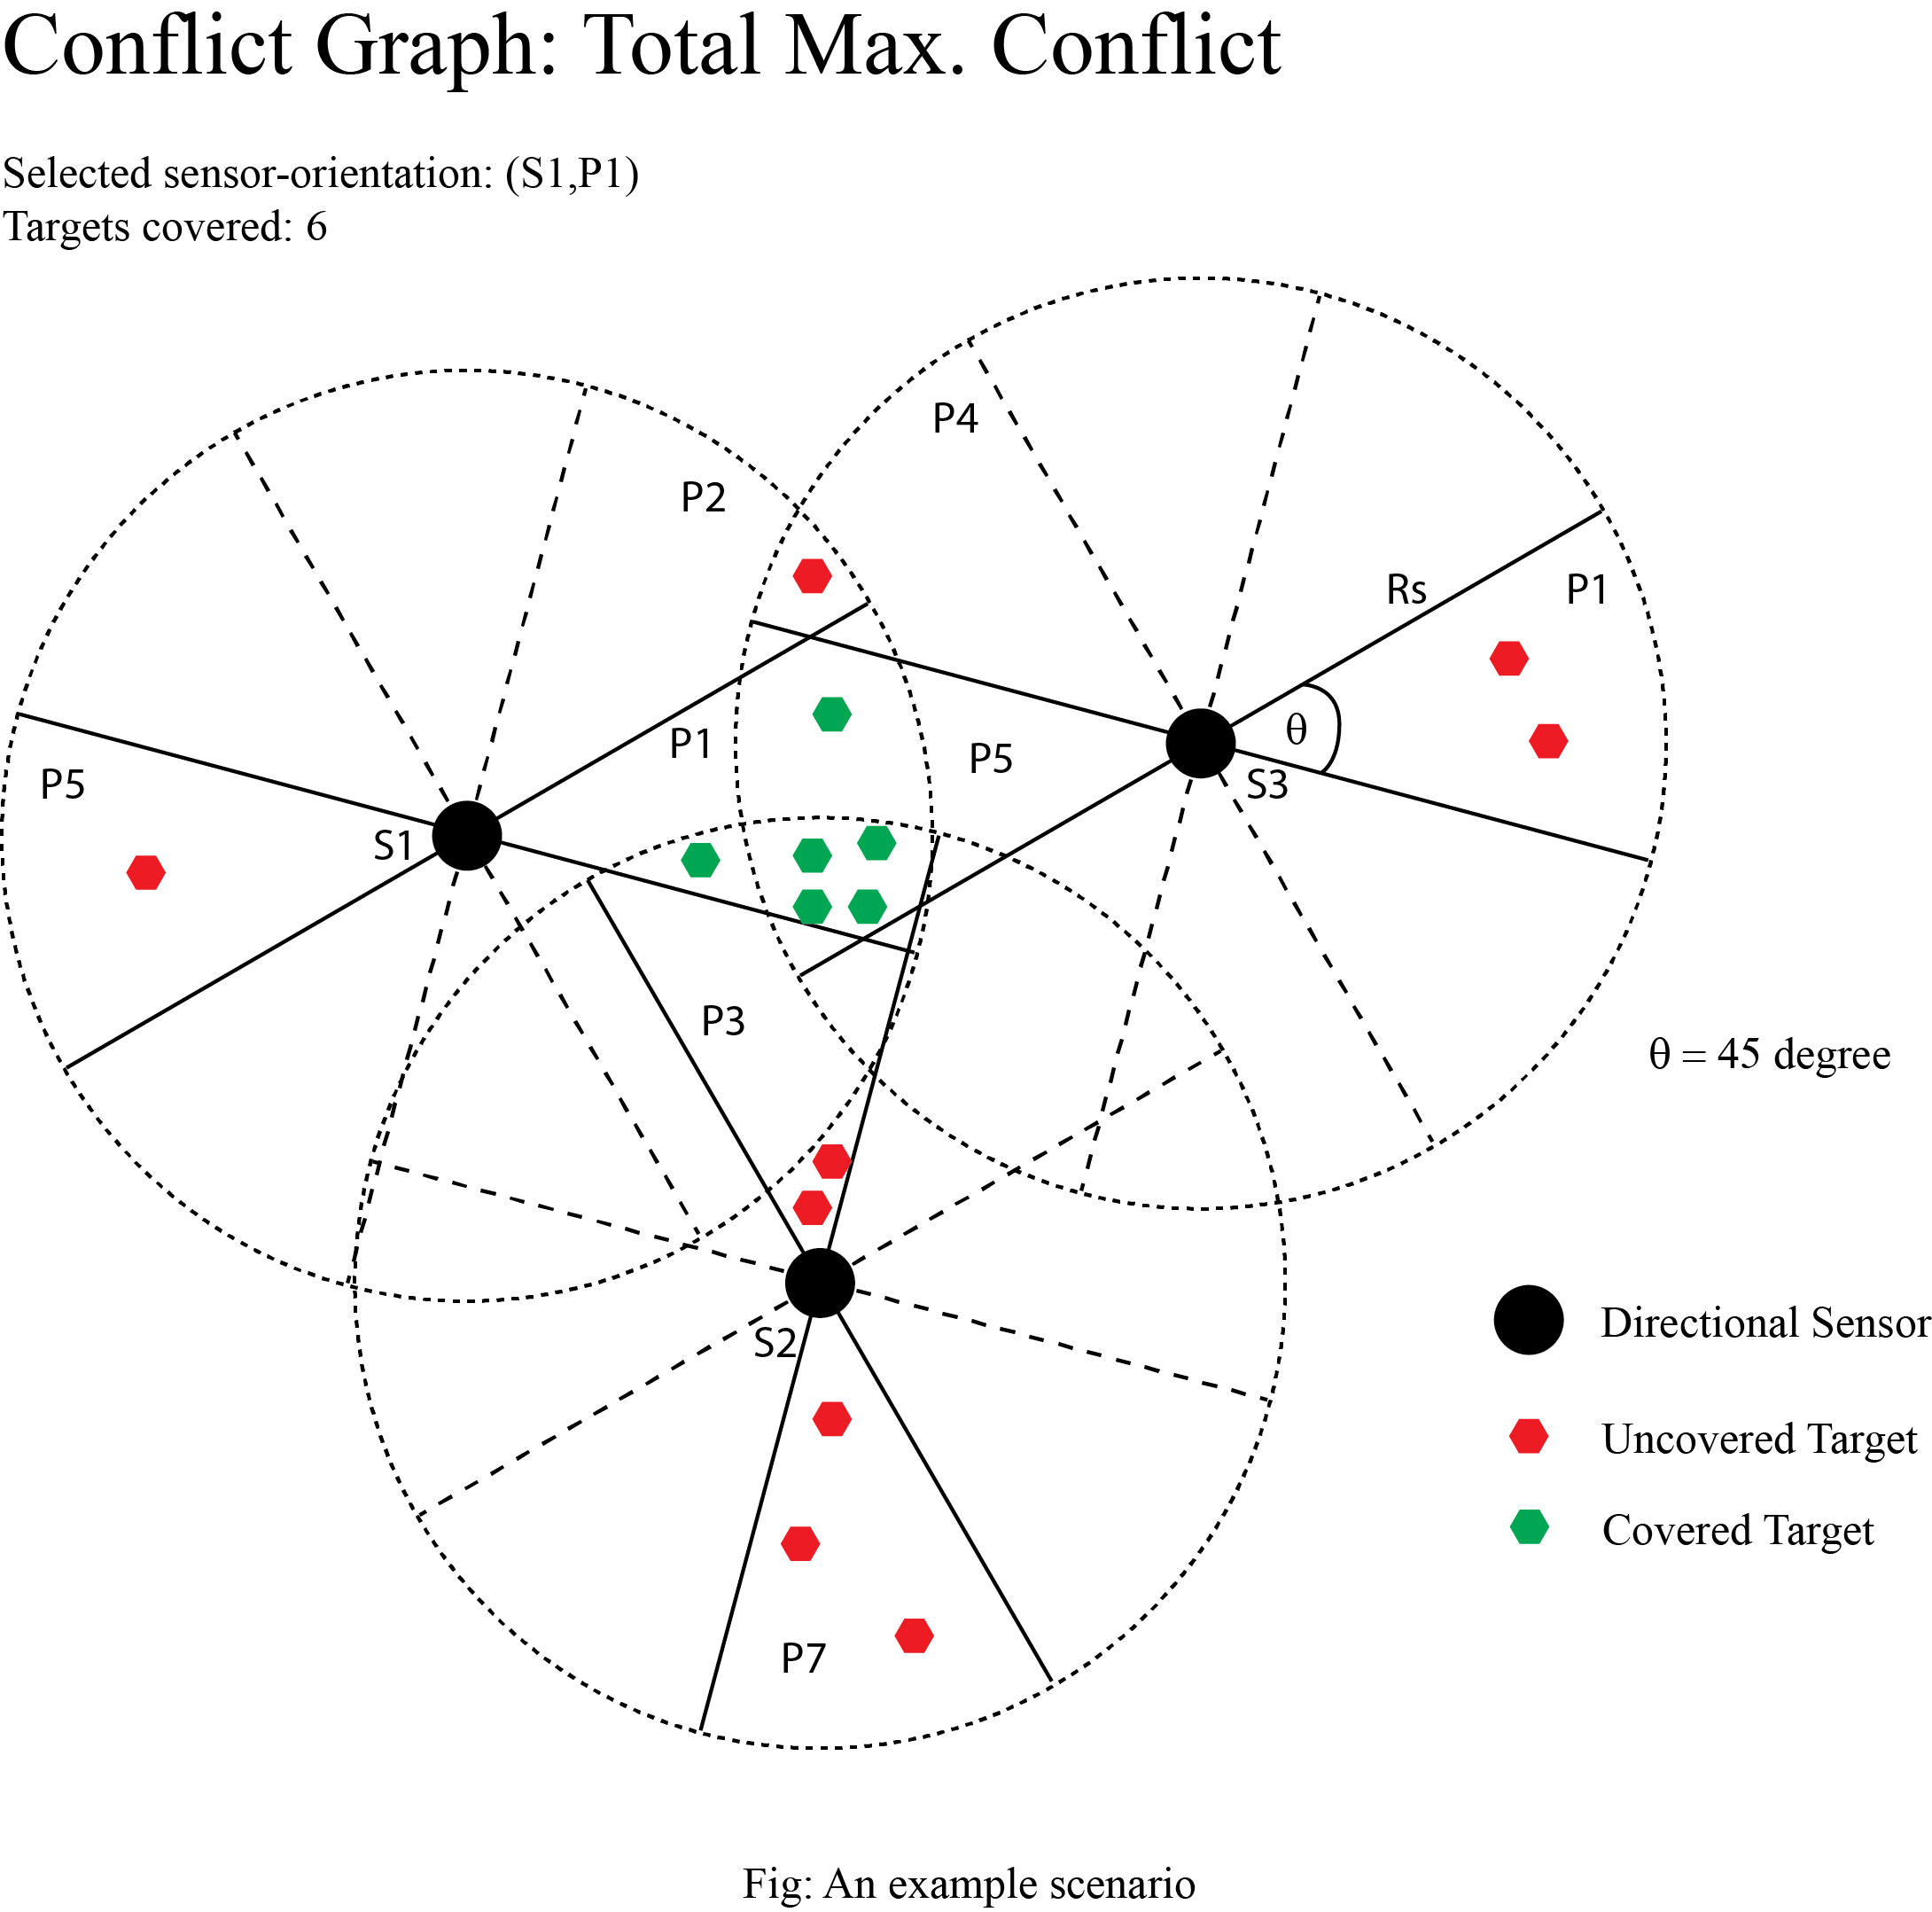

Slide 35
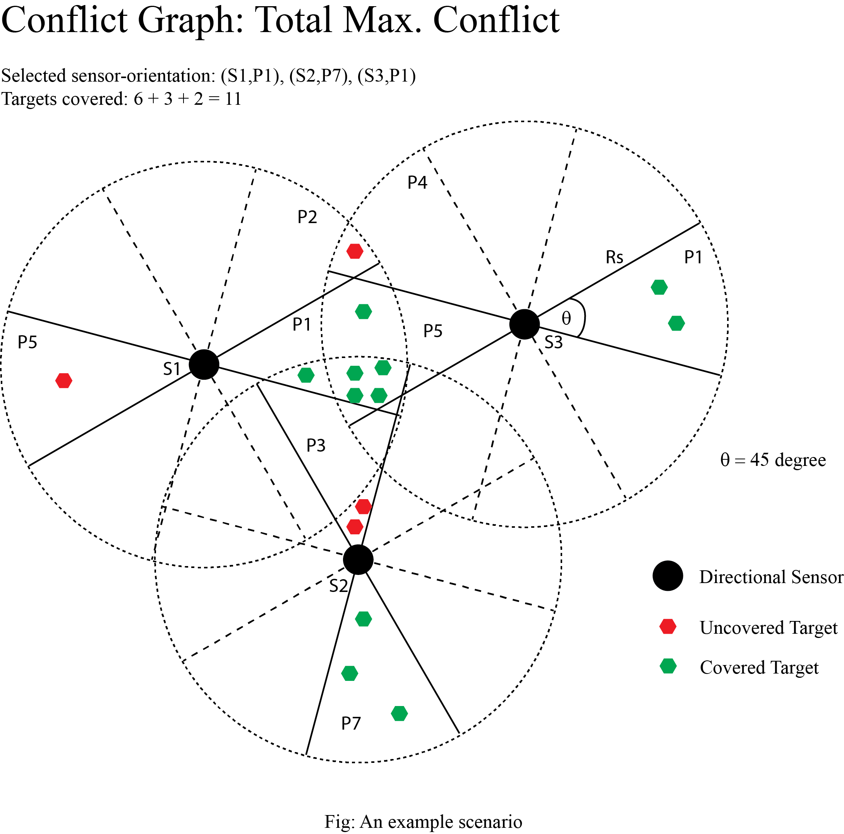

Slide 36
Challenges
We have to model the conflict-graph beforehand.
We have to formulate different heuristics suitable for applying to our graph model

Slide 37
Future Work plan
Formulate different new heuristics suitable to apply to our graph model
Evaluate performance of the new heuristics and compare them with the existing one’s.

Slide 38
Summary
Add new dimension to look at the problem and generate corresponding solution.
Graph approach will open new doors to explore the problem space for finding better solutions.
We can apply different heuristics to our graph modeling.

Slide 39
References
Will be added later on

Slide 40
Thank You…

Slide 41
Q/A…

